Slide 1
Introduction to Python Programming for Fabric Developers
Ted Pattison
Principal Program Manager
Power BI Customer Advisory Team (PBICAT)

Slide 2
Agenda
Python Execution Environments
Python Language Fundamentals
Data Structures
Managing Python Libraries

Slide 3
Setting Up For Local Python Development
Local PC
Visual Studio Code
MyPythonCode.py
PyLance
Python Runtime

Slide 4
Executing Python Code in Old School Power BI
Local PC
Power BI Service
Personal Gateway
Python Visual
Power Query M Code
MyPythonCode.py
MyPythonCode.py
Database
Dataset
Python Runtime

Slide 5
Executing Python Code in Fabric
Microsoft Fabric provides built-in Python support for Apache Spark
Includes support for PySpark
Python code can be run through Spark batch job definition
Python code can be executed interactive Fabric Notebook

Slide 6
Apache Spark Architecture
Apache Spark is an open-source, unified analytics engine
Very popular for processing Big Data projects
Batch processing, large-scale SQL, machine learning, and stream processing
Spark is a general-purpose, cluster computing framework
can distribute data processing tasks across many nodes to process Big Data

Slide 7
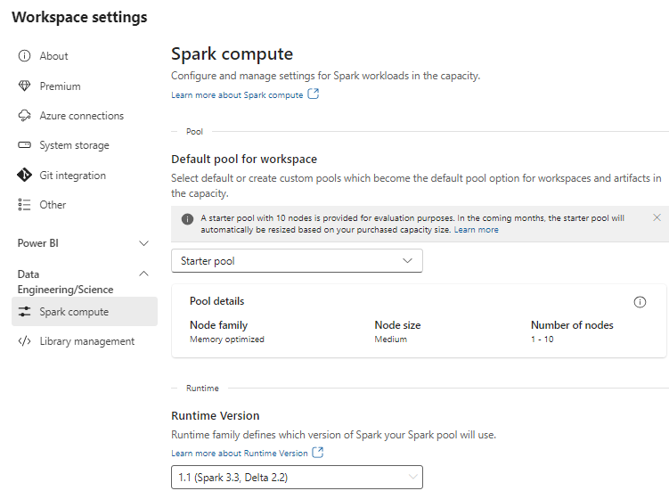

Slide 8
Fabric Notebooks
Notebook provides web interface to write and execute Python code
Language support for PySpark (Python), Spark (Scala), Spark SQL and SparkR
Allow author to mix [markup text] + [python code] + [visualizations] in single file
What are notebooks used for?
Apache Spark jobs
Machine learning experiments
Notebook structure
Notebooks created by adding cells

Slide 9
Notebook Sessions
Details to follow

Slide 10
Agenda
Python Execution Environments
Python Language Fundamentals
Data Structures
Managing Python Libraries

Slide 11
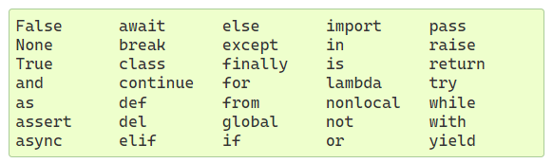
Python Fundamentals
Things about Python
It’s an interpretive language - not a language that gets compiled
Python code executes on a runtime layer
Getting started with Python syntax
Indentation – not braces
Everything is an object – objects have attributes and methods
Comments added using #
Keywords

Slide 12
Code Structure
Indents and continuation character
Indentation – not braces
Variables
Variables are created to reference objects
Variables do not have types – but the objects they reference have types
Variables point to objects
But variable and objects it points to are distinct

Slide 13
Conditional Execution
If, elif and else
Equality | ==
Inequality | !=
Less than | <
Less than or equal | <=
Greater than | >
Greater than or equal | >=

Slide 14
Strings
String literals can be enclosed in single or double quotes
Use double quotes inside string created with single quotes or vice versa
Triple quote used to add literal quote into string
Formatted string preceded with f or F
Raw strings preceded with r or R

Slide 15
Extracting Slices from a String
ssss
[:] | Extract entire string
[ start:] | Extracts from start offset to end
[: end] | Extracts from start to end offset minus 1
[ start : end ] | Extracts from start offset to end offset minus 1
[ start : end : step ] | Extracts from start offset to end offset minus 1by step increment

Slide 16
String Functions
len()
split()
join()
replace()
strip()

Slide 17
Formatted Strings

Slide 18
Looping and Enumeration
while loops
for in

Slide 19
Generating Number Sequences with range()
range()

Slide 20
Agenda
Python Execution Environments
Python Language Fundamentals
Data Structures
Managing Python Libraries

Slide 21
Tuples

Slide 22
Lists
create list with []
access list item with [offset]
Create list with list()
Modify list with append() and insert()
Delete list item with del

Slide 23
Tuples versus Lists
Tuples use less space
You cannot clobber tuple items by mistake
You can use tuples as dictionary keys
Tuples can be named

Slide 24
Dictionaries
create with {}
create with dict()
Add or change and item by [ key ]
Retrieve using item(), keys() or values()

Slide 25
Sets
a collection of unique key
no values
determine if value exists

Slide 26
Agenda
Python Execution Environments
Python Language Fundamentals
Data Structures
Functions
Managing Python Libraries
Writing Data
Visualizing Data

Slide 27
Defining and Calling Functions
define using def
Passing arguments
What are Keyword Arguments

Slide 28
Explode/Gather Keyword Arguments with **
Explode/Gather positional Arguments with *
Explode/Gather Keyword Arguments with **

Slide 29
Functions Are Objects
Inner functions
Closures
Anonymous functions (lambda)
Generator functions

Slide 30
Namespace and Scope

Slide 31
Exception Handling

Slide 32
Defining Classes
Encapsulation

Slide 33
Object-oriented Programming Support
Inheritance and polymorphism
Multiple Inheritance
Mixins

Slide 34
Named Tuples

Slide 35
Modules
What is a module
Hierarchical set of modules publish using packages

Slide 36
Importing Modules

Slide 37
Managing Python Libraries in Fabric
Feed Library
Custom Library
Installing Workspace Libraries

Slide 38
Installing Python Libraires in a Notebook

